Slide 1


Team 42: Multi-Axis Cobot for Factory Automation
Bi-Weekly Update 3 Emily Hamsa, Ethan Woods, Adrian Guzman, Jaishil Shah
Sponsor: Will Hofstetter
TA: Vishwam Raval
Notes:
Michelle

Slide 2

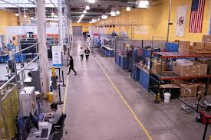
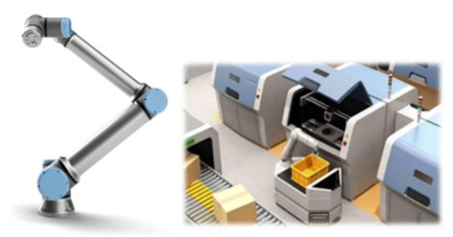
Project Summary
Problem statement:
Factory settings pose dangerous environments to human workers through the exposure to heavy machinery, tight spaces, and repetitive workloads. These hazards increase chance of injury and worker burnout. We need to implement collaborative robots (Cobots) to improve worker conditions.
Human Injury & Burnout in Warehouses
Cobot Solution
Notes:
Adrian

Slide 3
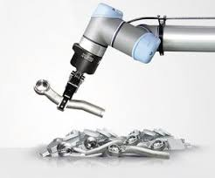
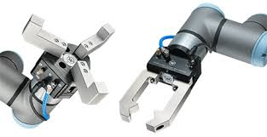
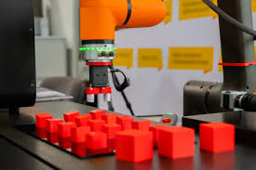
Project Summary
Solution proposal:
Develop a Cobot that can integrate into a factory environment to reduce human injury, worker burnout, and increase productivity in repetitive tasks. The Cobot shall be able to lift (1-2 lbs) and be placed into tight environments and controlled wirelessly through mobile app.
Repetitive Tasks
1-2 lbs. Load
Precise Control
Notes:
Ethan

Slide 4
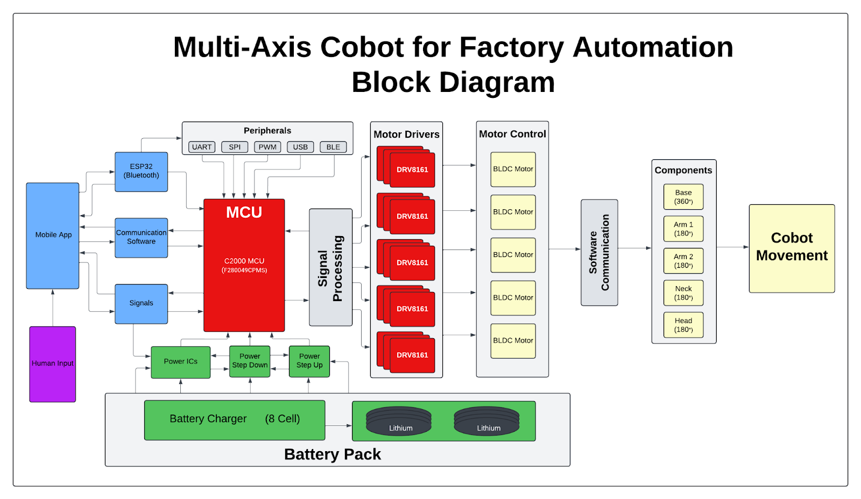
Project/Subsystem Overview
Adrian
Ethan
Jaishil
Emily
Subsystem Diagram Color: Power, MCU/Connectivity, Mobile App, Motor Control

Slide 5
Project Timeline
Review/update progress since E403
Team finalizing design of new PCBs
Order PCB and components
Conversation over physical structure of cobot arm…(Amazon purchase with 1x BLDC motor and 3x-4x Servo)
Team is fixing issues with integration between subsystems
Reviewing bugs/fixing problems
Cobot arm should have clear path and deliverables
Team is fully integrated and operational
Cobot arm is moving
Fix issues with accuracy and movement of arm
Update #2 (Feb 3)
Update #4 (Mar 3)
Final #6 (Apr 7)
Update #1 (Jan 15)
Update #3 (Feb 17)
Update #5 (Mar 24)
Finish putting together new generation boards
Test and validate to ensure functionality
Cobot arm delivered and brainstorm ideas
Integration should be nearing completion
Cobot arm is revamped and near operation
Issues should be resolved with subsystems
Cobot arm is working as expected and can pick up objects that meet the restrictions
Team is making project look visually appealing
Cosmetic touch ups
Notes:
Required:
High level figure showing where you are at in the project, what’s completed, what’s underway – it should take about 30 seconds to summarize where you are in the timeline
-- Save discussion for subsystem update
-- Save detail for execution plan & validation plan status

Slide 6
Motor/Motor Driver Subsystem
Ethan Woods
Accomplishments since last update 18 hours of effort | Ongoing progress/problems and plans until the next presentation
Finished Soldering Final Board Over 200 (surface mount) components! Completed testing Motor Drivers using GUI.c code for the DRV8161 EVM and Launchpad. Successful motor motion during the testing Varying Duty %, Clockwise, Counter-clockwise, Stopping Began integration with MCU Subsystem Assisting where needed | Ongoing integration with MCU Subsystem Breaking down GUI.c to produce and replicate our own version for movement Begin testing into encoder for precise movement of the motor Continue research into motor mounting hubs/couplers for attachment into Robotic Arm Assist group-wide integration as needed
Notes:
For 3nd review Accomplishments should include what integration was completed and what functional system test (testing of what you integrated) has been completed. Include resolution of any KEY subsystem issues.
“Completed integration of MCU with Lidar camera”
“Completed testing of integrated motor controller and MCU for forward high speed and low speed and reverse movement”
“ON-GOING functional testing of complete system including vision system, navigation, obstacle avoidance, and object detection”
“Full system integration will be completed by next review”

Slide 7

Motor/Motor Driver Subsystem
Ethan Woods
Motor Motion using Gui.c and Launchpad Integration:
Narrowing Down the Goals!
Main Movement:
Motor Movement at a defined Duty Cycle %
Determines Speed of Shaft (Torque)
Clockwise/CCW Movement
Acceleration to Speed
Deceleration to Stopping
Precise Control:
Encoder Driven Precise Movement
Fault Detection, Prevention, and Response
User Input (Direction, Speed, On/Off)
How? - > By taking the existing GUI.c code and adjusting specifications to what the group needs.
Whats next? -> Begin working to control precise movement and integration into the Cobot.

Slide 8
MCU/Processing Subsystem
Adrian Guzman
Accomplishments since last update 30 hrs of effort | Ongoing progress/problems and plans until the next presentation
MCU & Servo Motor Completed integration of MCU and Servo motors for 4-axis movement MCU & Motor Driver Integration Completed integration of Motor Driver to MCU using software in CCS. Ongoing software development for user input control of BLDC motor MCU & Wireless App Validated MCU capabilities of receiving input from mobile app to move cobot Completed user input functionality through 8 toggle GPIO pins | Solder second MCU board BLDC and servo motors use different header files that can’t both be flashed onto one chip Easier to dedicate one MCU board to Servos and another to BLDC motor Code for BLDC motor Add to current GUI.c code allowing human input to control BLDC motor After completion, test functionality with wireless and motor driver subsystems Integrate to power subsystem
Notes:
Required: What has been accomplished (not just started) – is it back up and running from 403? | What are you going to accomplish in the next 2 weeks | -- “Started, began, initiated…” are not accomplishments
--You do not need to have any accomplishment on some updates if you describe in “Ongoing” what work you have been doing
-- Make things here specific and measurable/verifiable
For 3nd review Accomplishments should include what integration was completed and what functional system test (testing of what you integrated) has been completed. Include resolution of any KEY subsystem issues.
“Completed integration of MCU with Lidar camera”
“Completed testing of integrated motor controller and MCU for forward high speed and low speed and reverse movement”
“ON-GOING functional testing of complete system including vision system, navigation, obstacle avoidance, and object detection”
“Full system integration will be completed by next review”

Slide 9
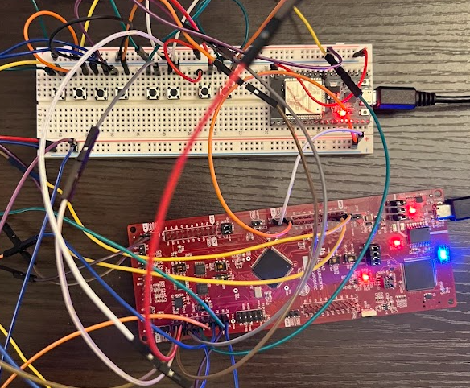
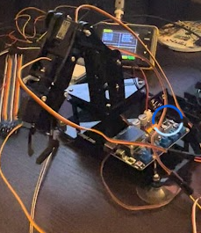
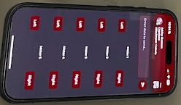
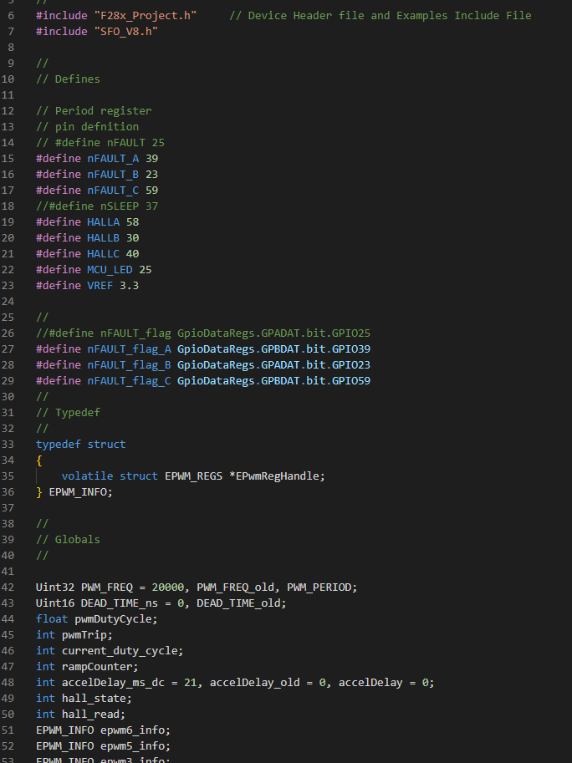
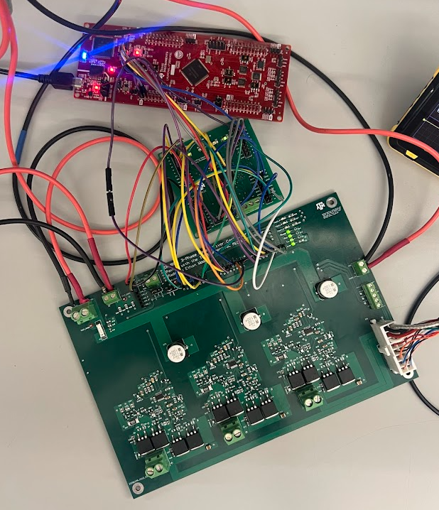
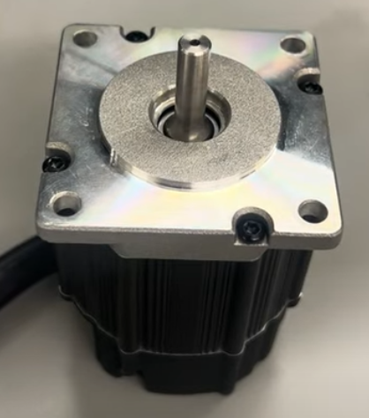
MCU/Processing Subsystem
Adrian Guzman
Movement Input Buttons
4-axis Servo Movement
Physical Button Replacement on mobile app
Integration of Motor Driver and MCU
Software flashed onto MCU to spin the BLDC motor
Notes:
Required: Interesting figure related to your subsystem progress. Detail on what works, what doesn’t, what is changing.

Slide 10
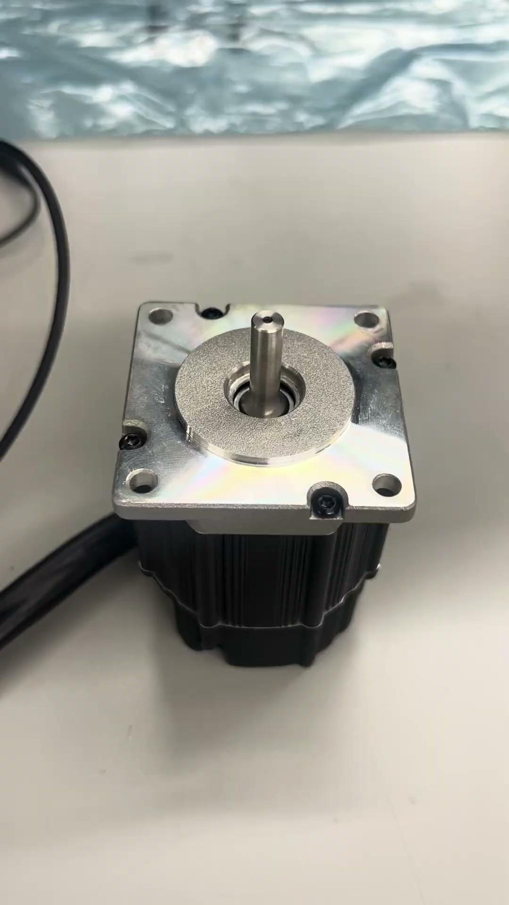
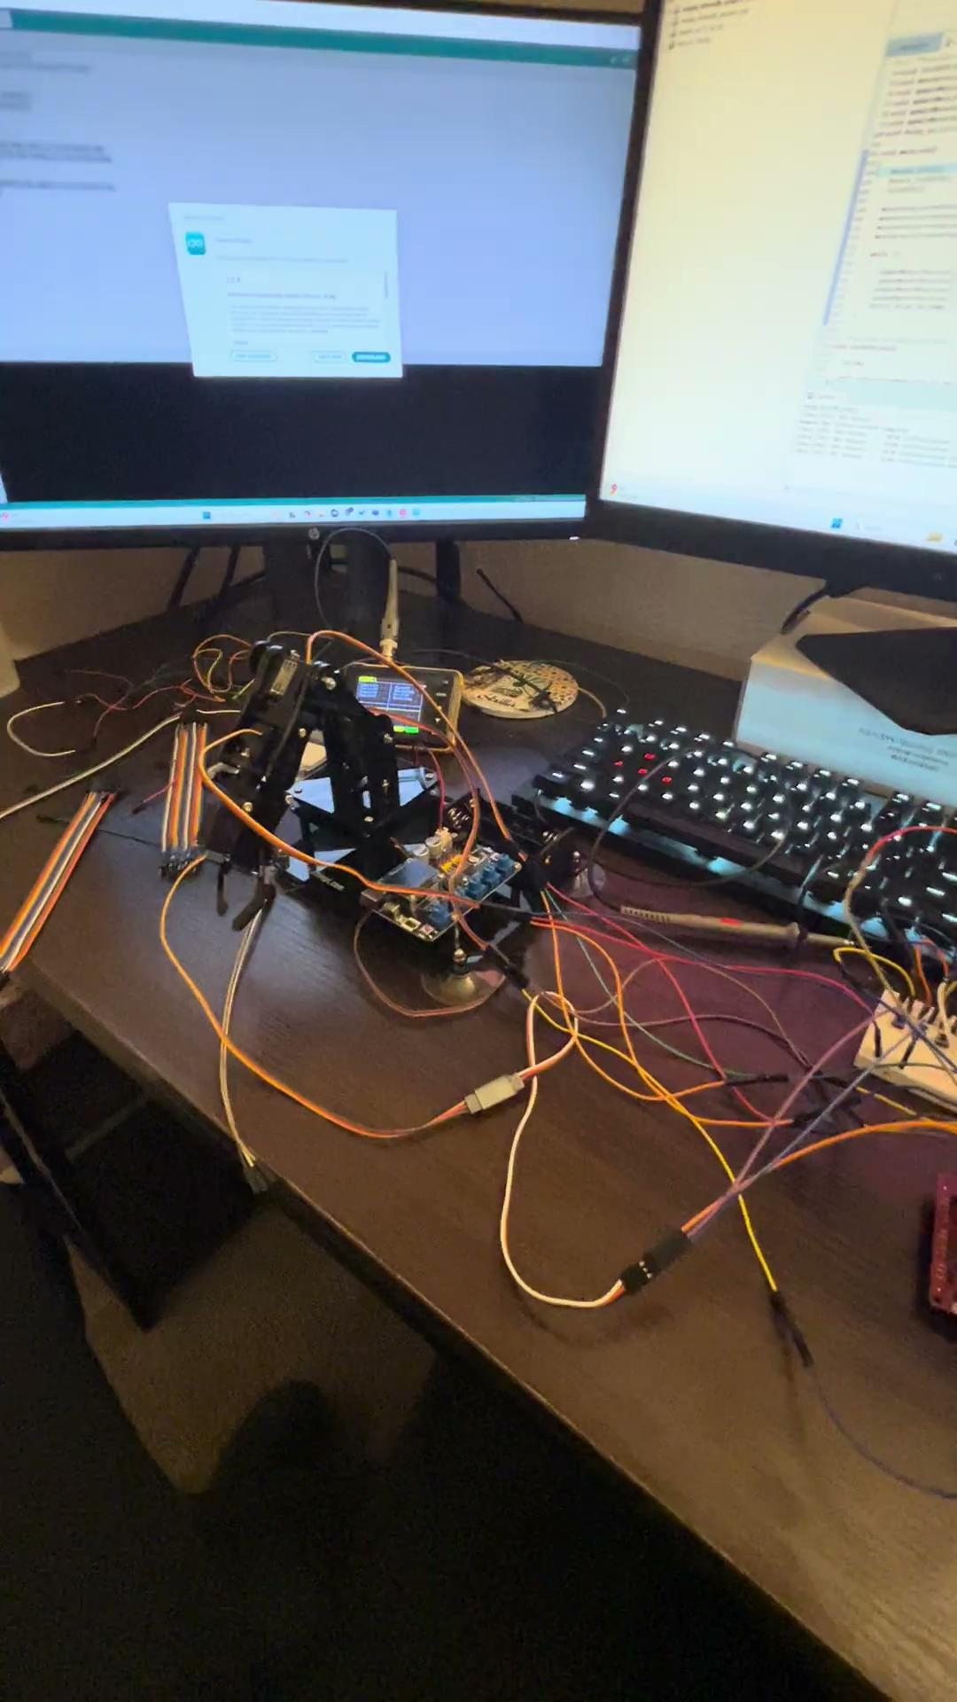
VIDEO
Wireless Input to Cobot
BLDC Motor
Cobot Picking Up

Slide 11
Power/Battery Management Subsystem
Emily Hamsa
For 3nd review Accomplishments should include what integration was completed and what functional system test (testing of what you integrated) has been completed. Include resolution of any KEY subsystem issues.
“Completed integration of MCU with Lidar camera”
“Completed testing of integrated motor controller and MCU for forward high speed and low speed and reverse movement”
“ON-GOING functional testing of complete system including vision system, navigation, obstacle avoidance, and object detection”
“Full system integration will be completed by next review”
Accomplishments since last update 20 hrs of effort | Ongoing progress/problems and plans until the next presentation
Completed soldering and assembling my PCB Began testing Validated correct voltage output for 10V, 15V, 20V, 25V, and 48V input Began work on physical design fabrication Cut acrylic and wood boards in size 11”x14” | Complete validation of subsystem Test with E-Load Test for noise in output Further test integration Test compatibility with Servo Motors and BLDC motor Complete physical design Adhere together and drill screw holes in boards and adhere PCBs to base

Slide 12
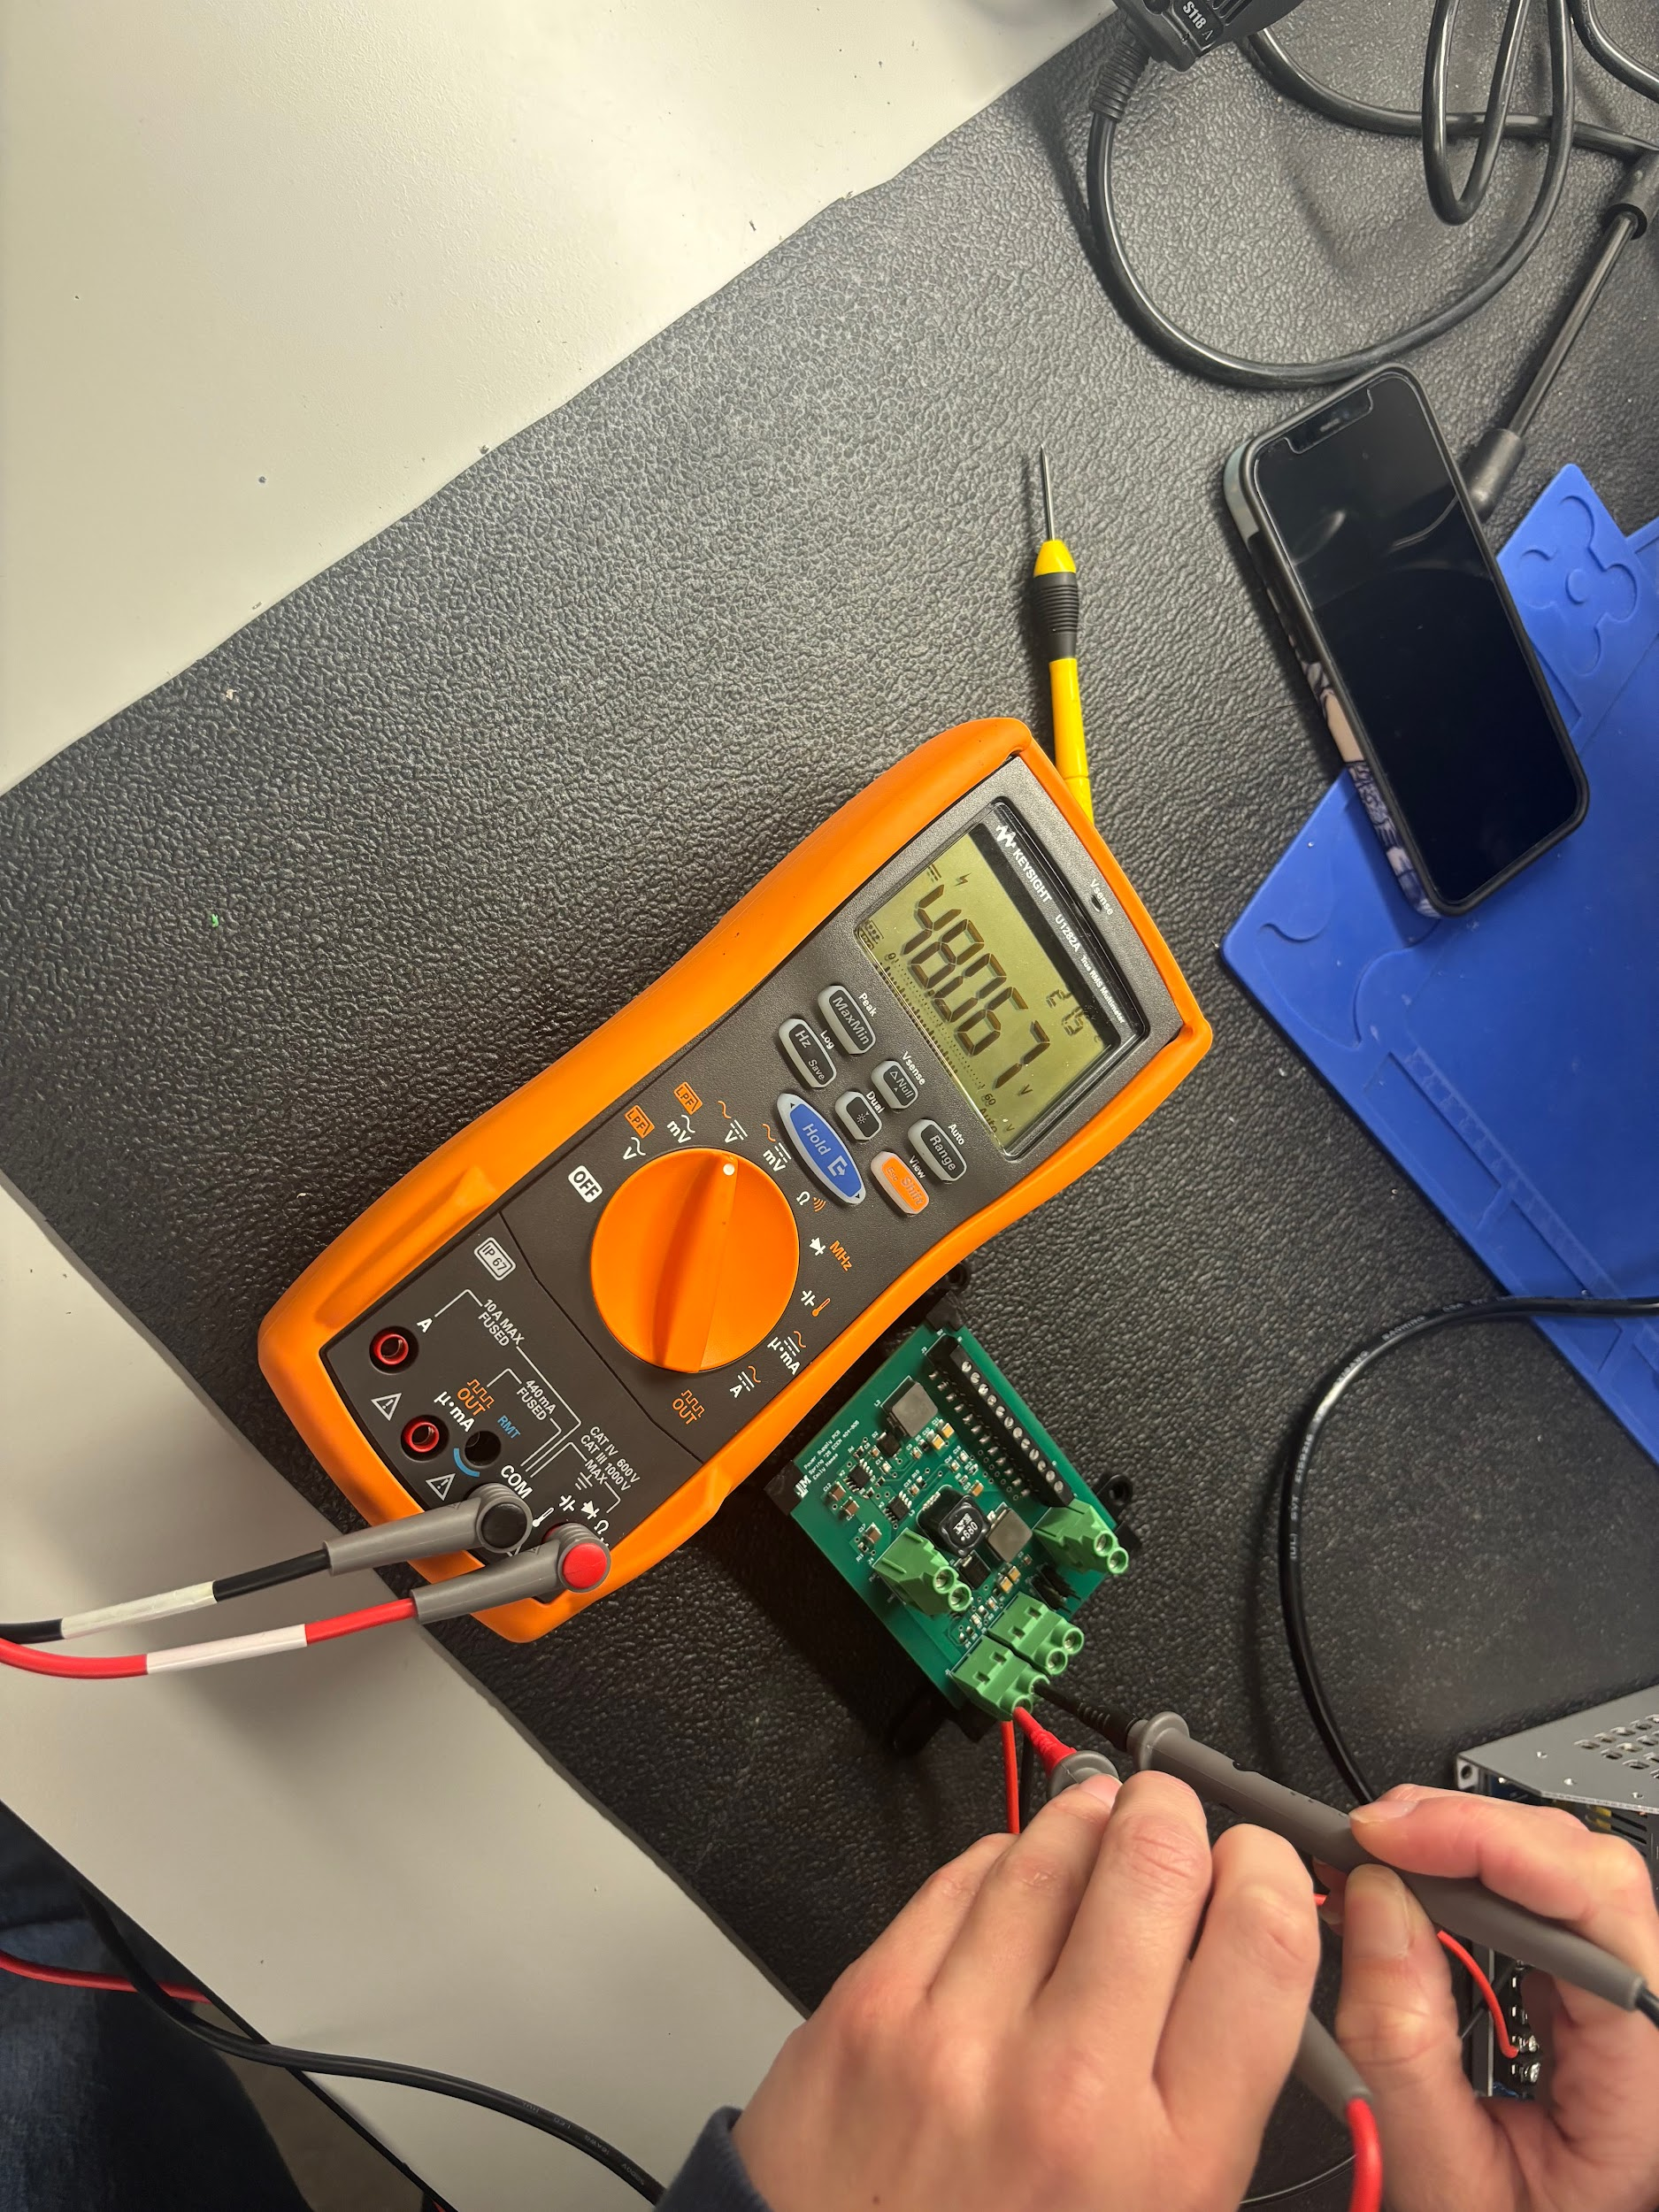
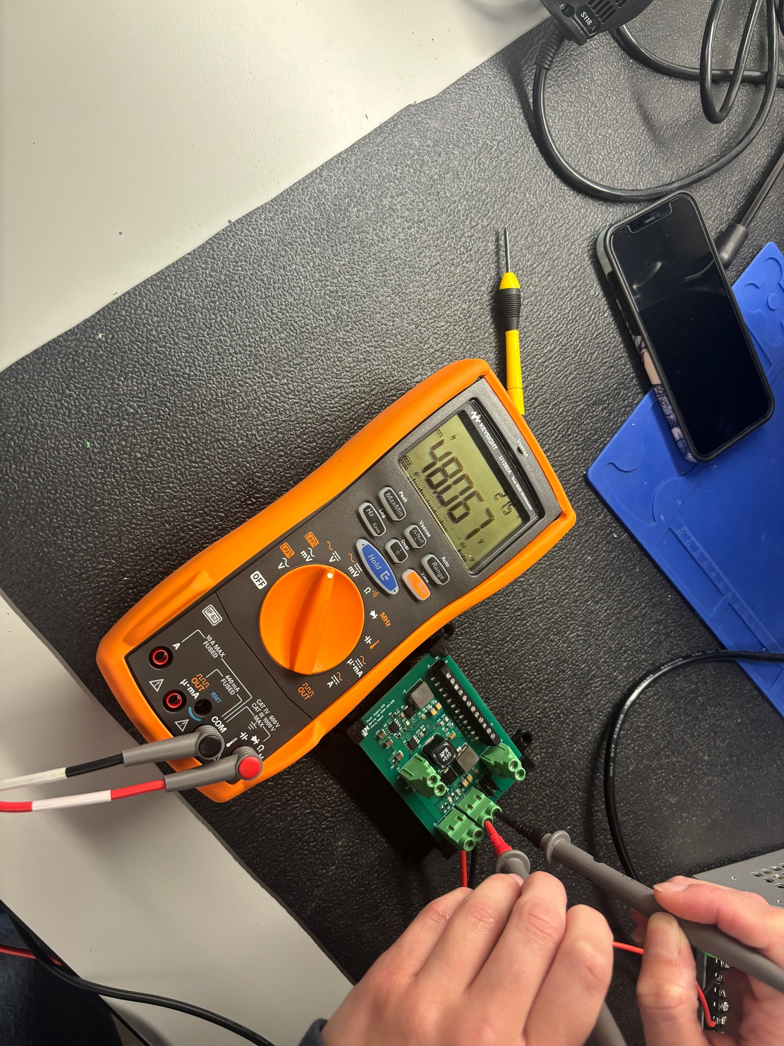
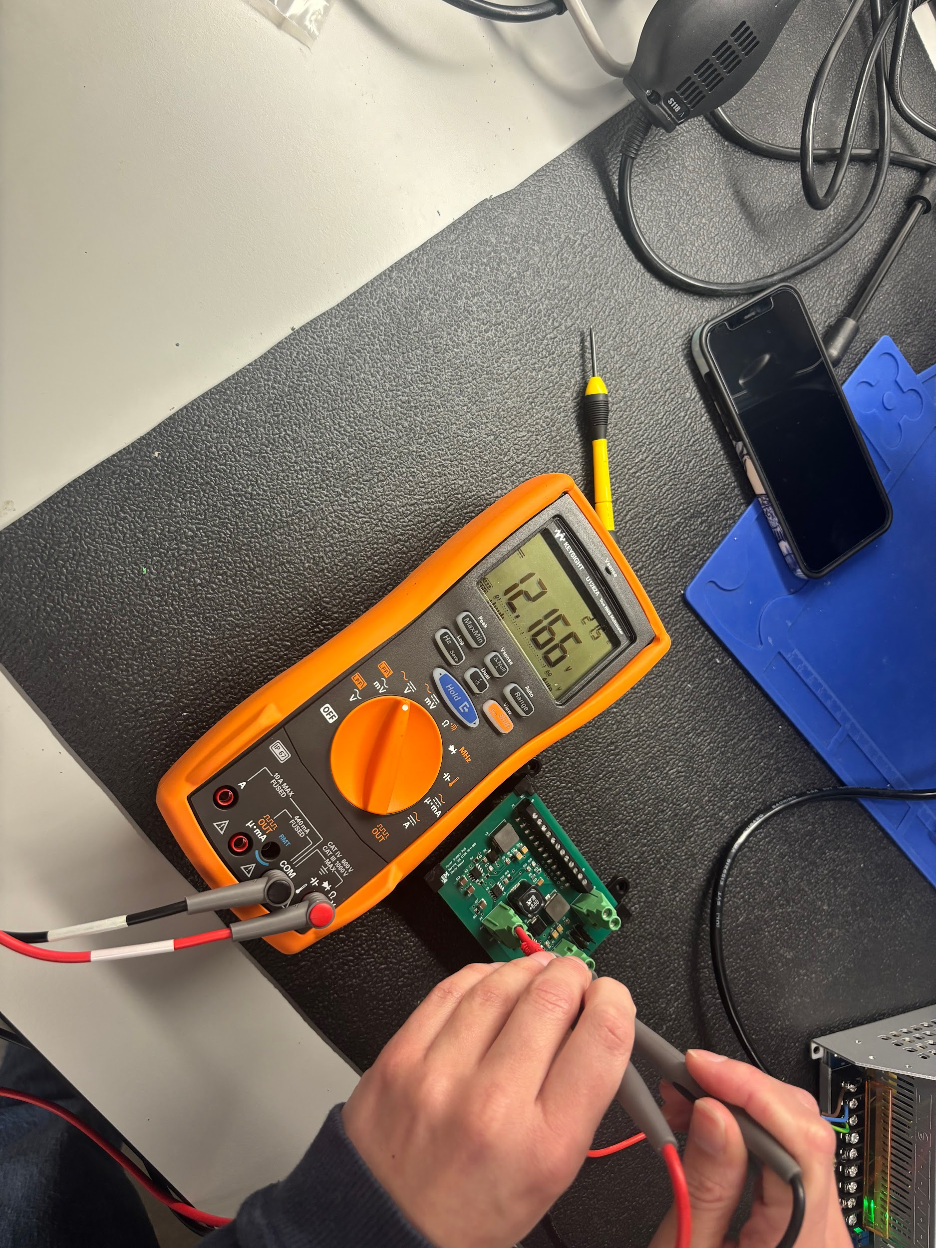
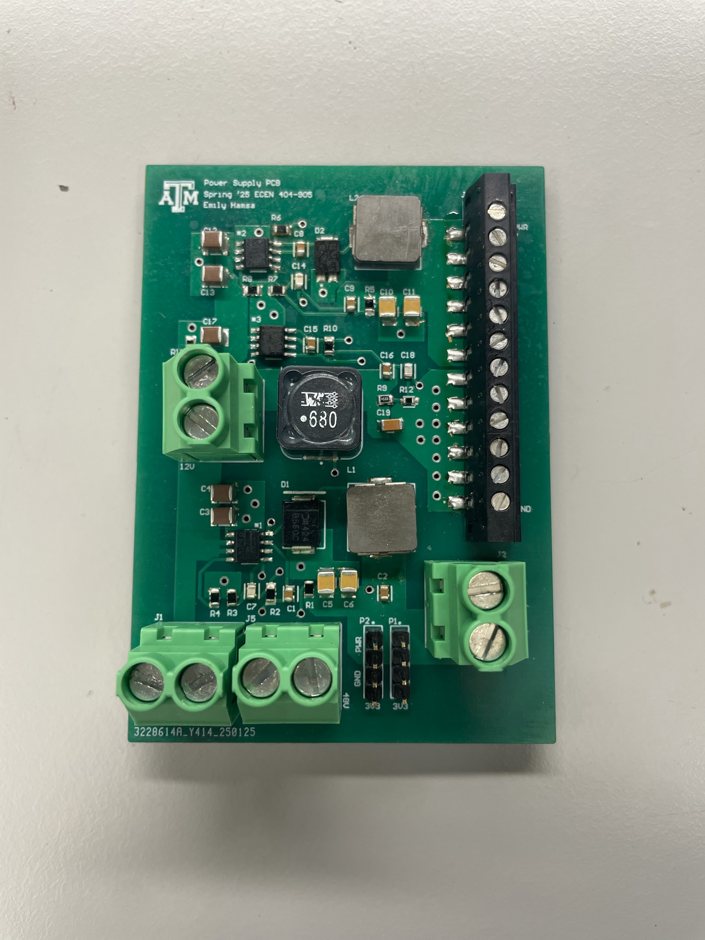
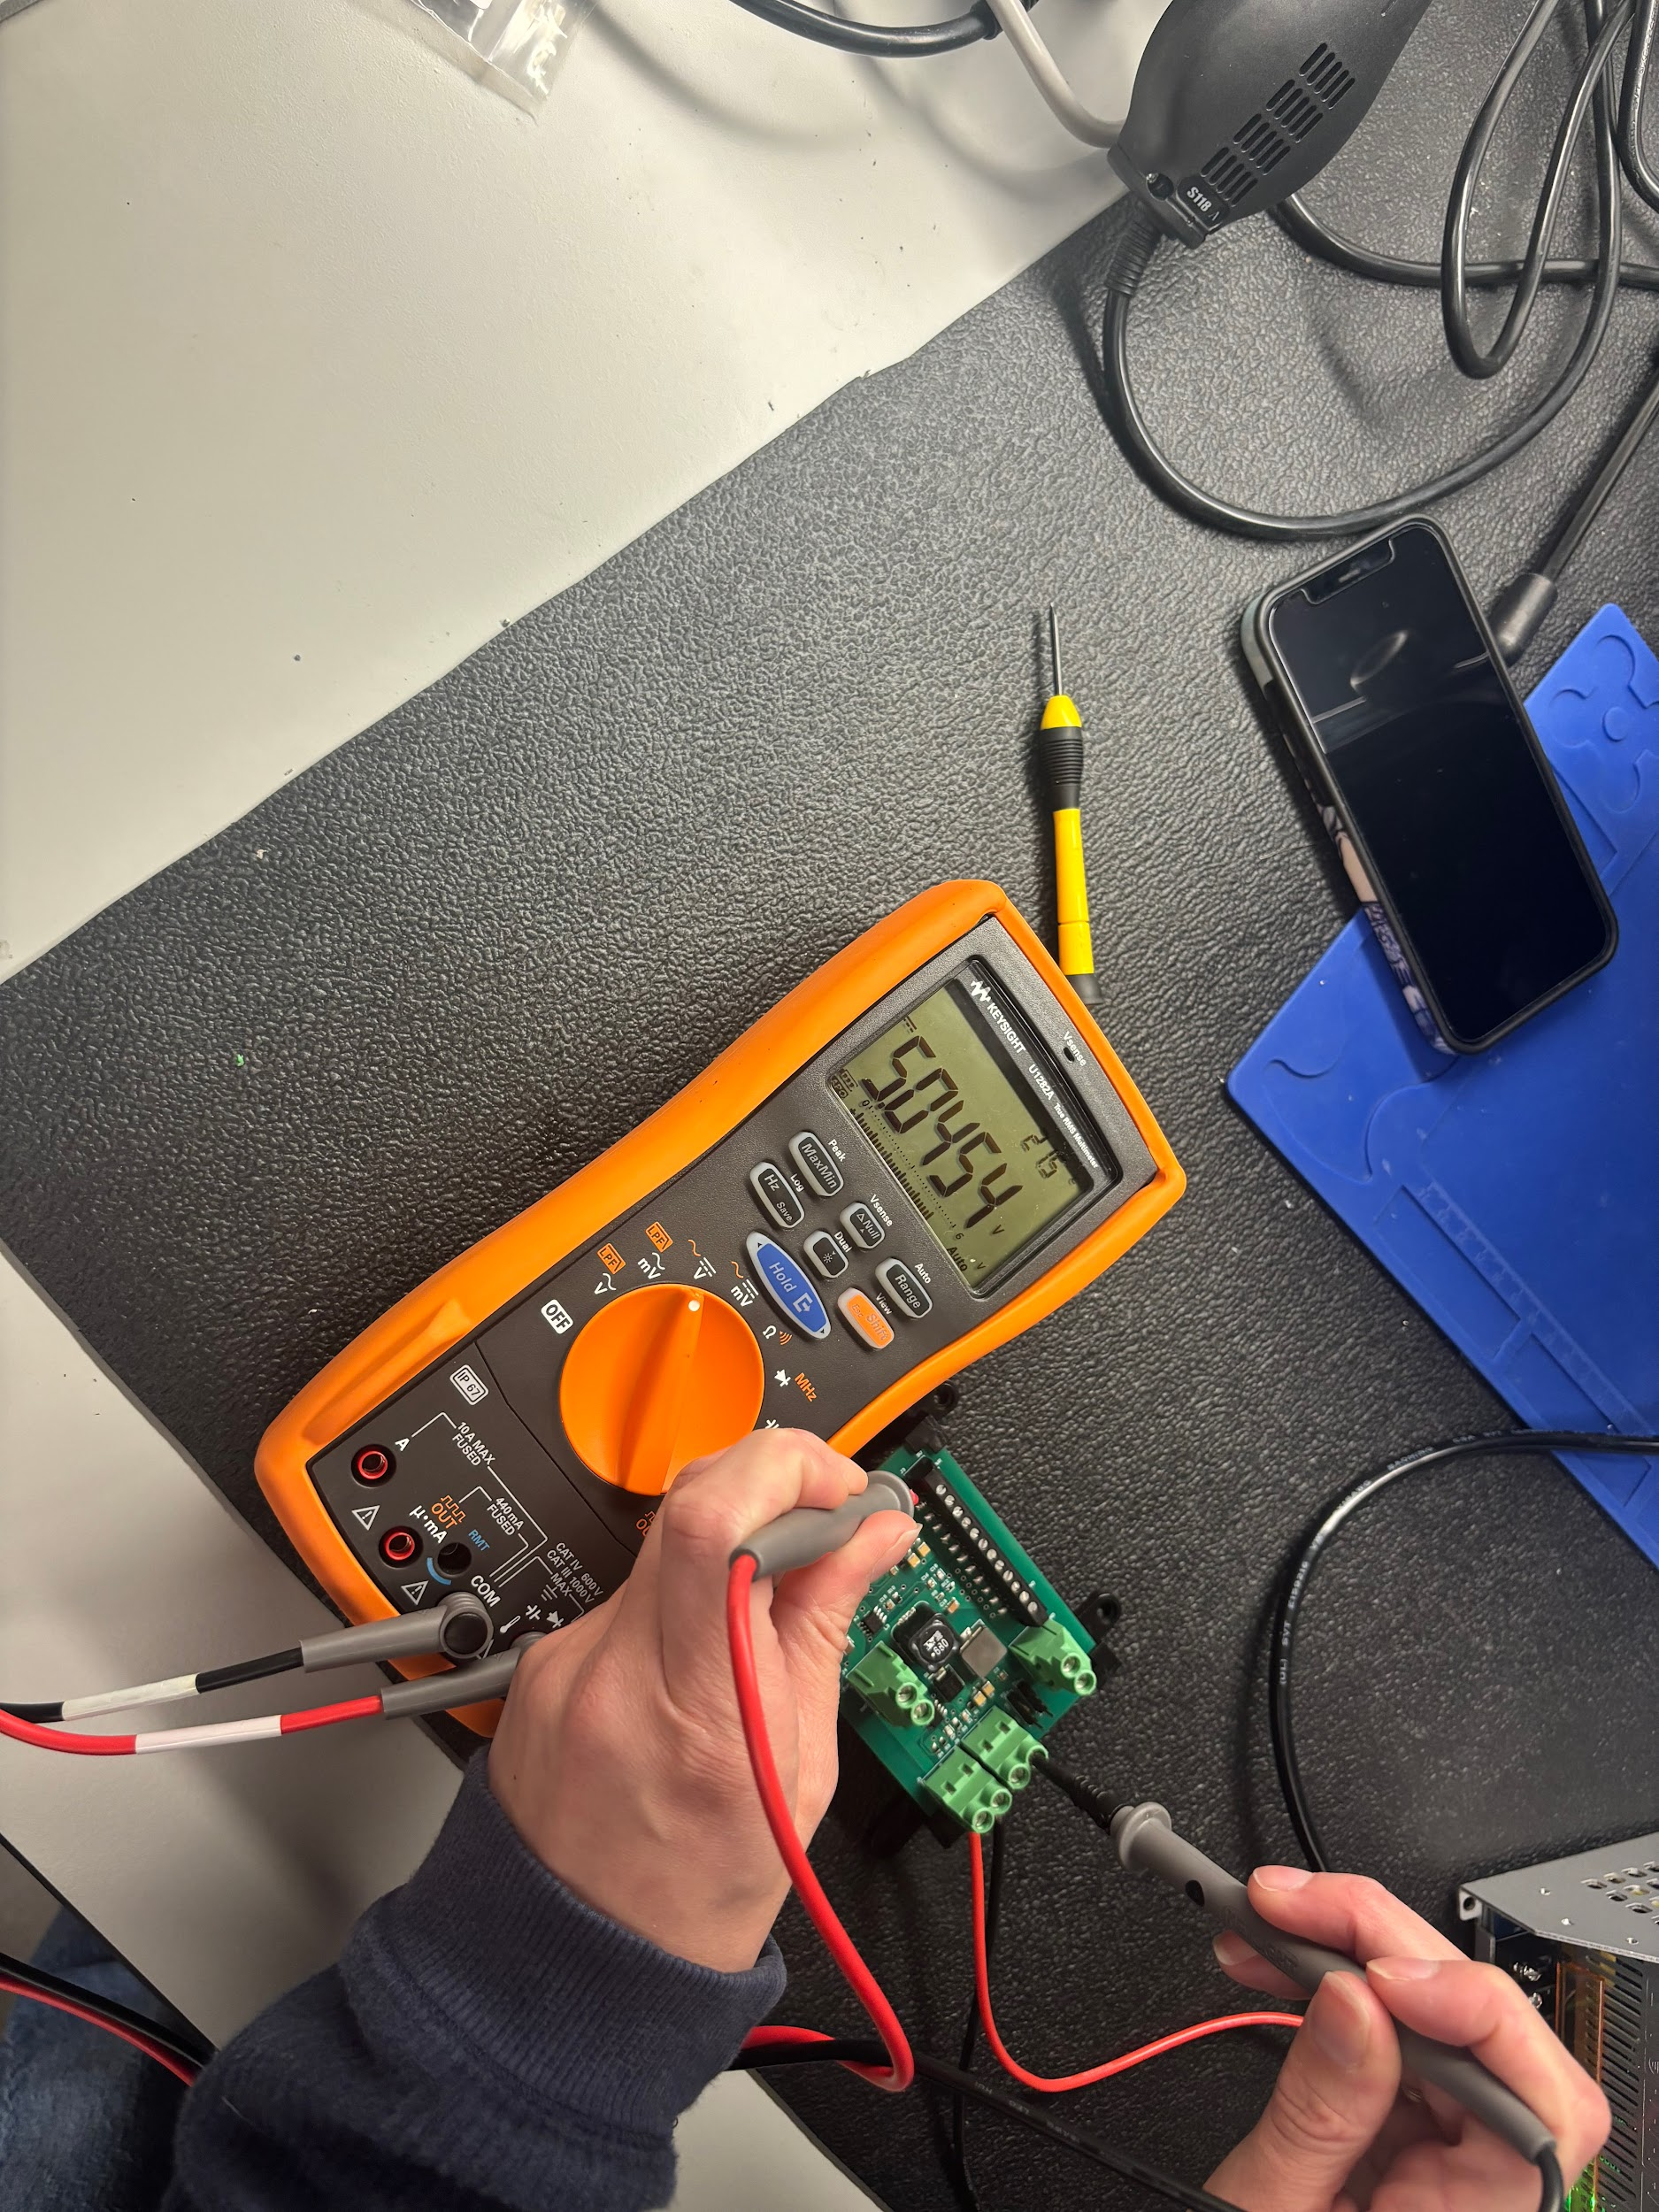
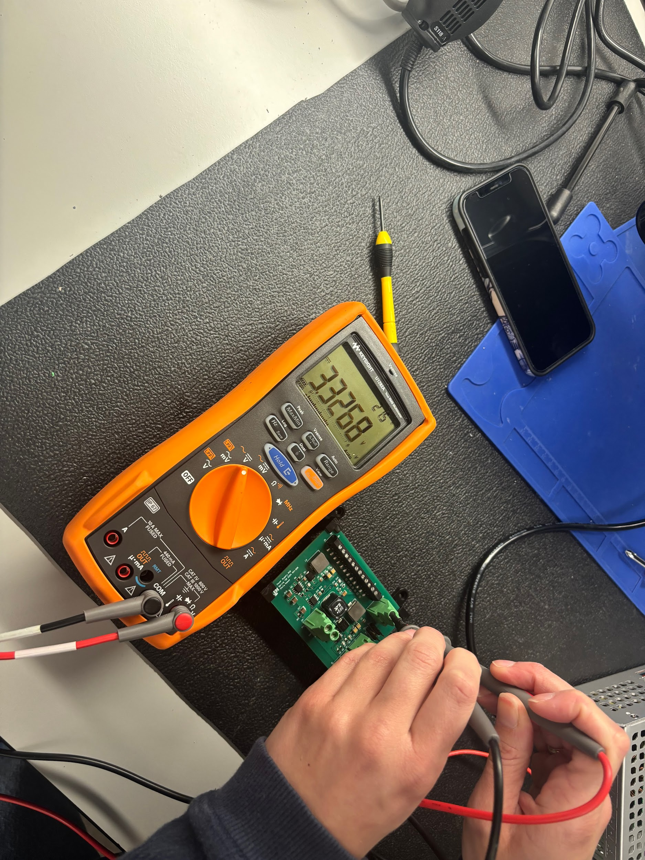
Power/Battery Management Subsystem
Emily Hamsa
Interesting figure related to your subsystem
progress ---
Best to show:
Results from prep for integration => integration
=> test of integrated subsystems
5V
Output
12V
Output
48V Input
48V Output
12V Output
3V3 Output
48V Input
48V Output
5V Output
3V3 Output

Slide 13
UI/Wireless Connectivity Subsystem
Jaishil Shah
Accomplishments since last update 18 hrs of effort | Ongoing progress/problems and plans until the next presentation
- Fabricated the base for the physical apparatus (wood & acrylic) - Moved Cobot motors wirelessly via mobile application - Finalized App version and functionality - Ensured a stable wireless connection & steady connectivity - Successful communication to ESP-32 & MCU via 10 GPIO pins | - Mounting PCBs and cobot onto physical apparatus - Tinker with BLE connection & UART communication - Accomplish wireless communication with the BLDC motors - Power the ESP-32 via Power Supply

Slide 14
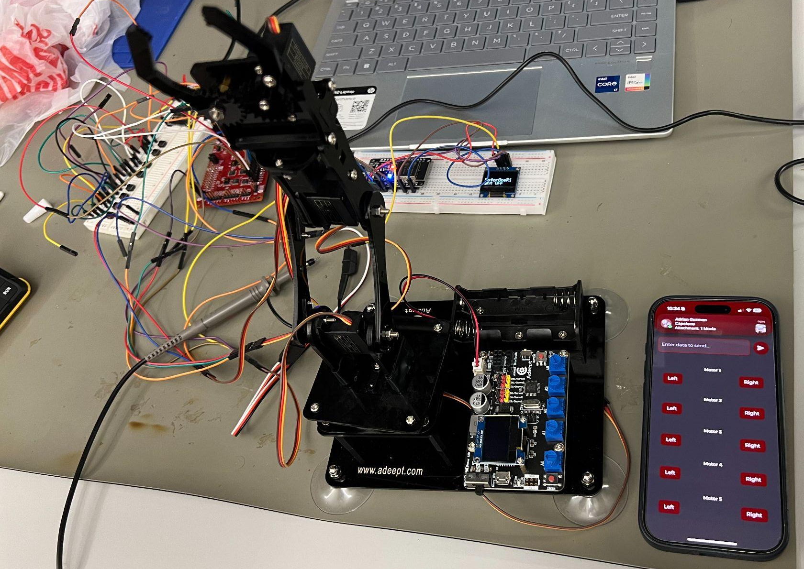
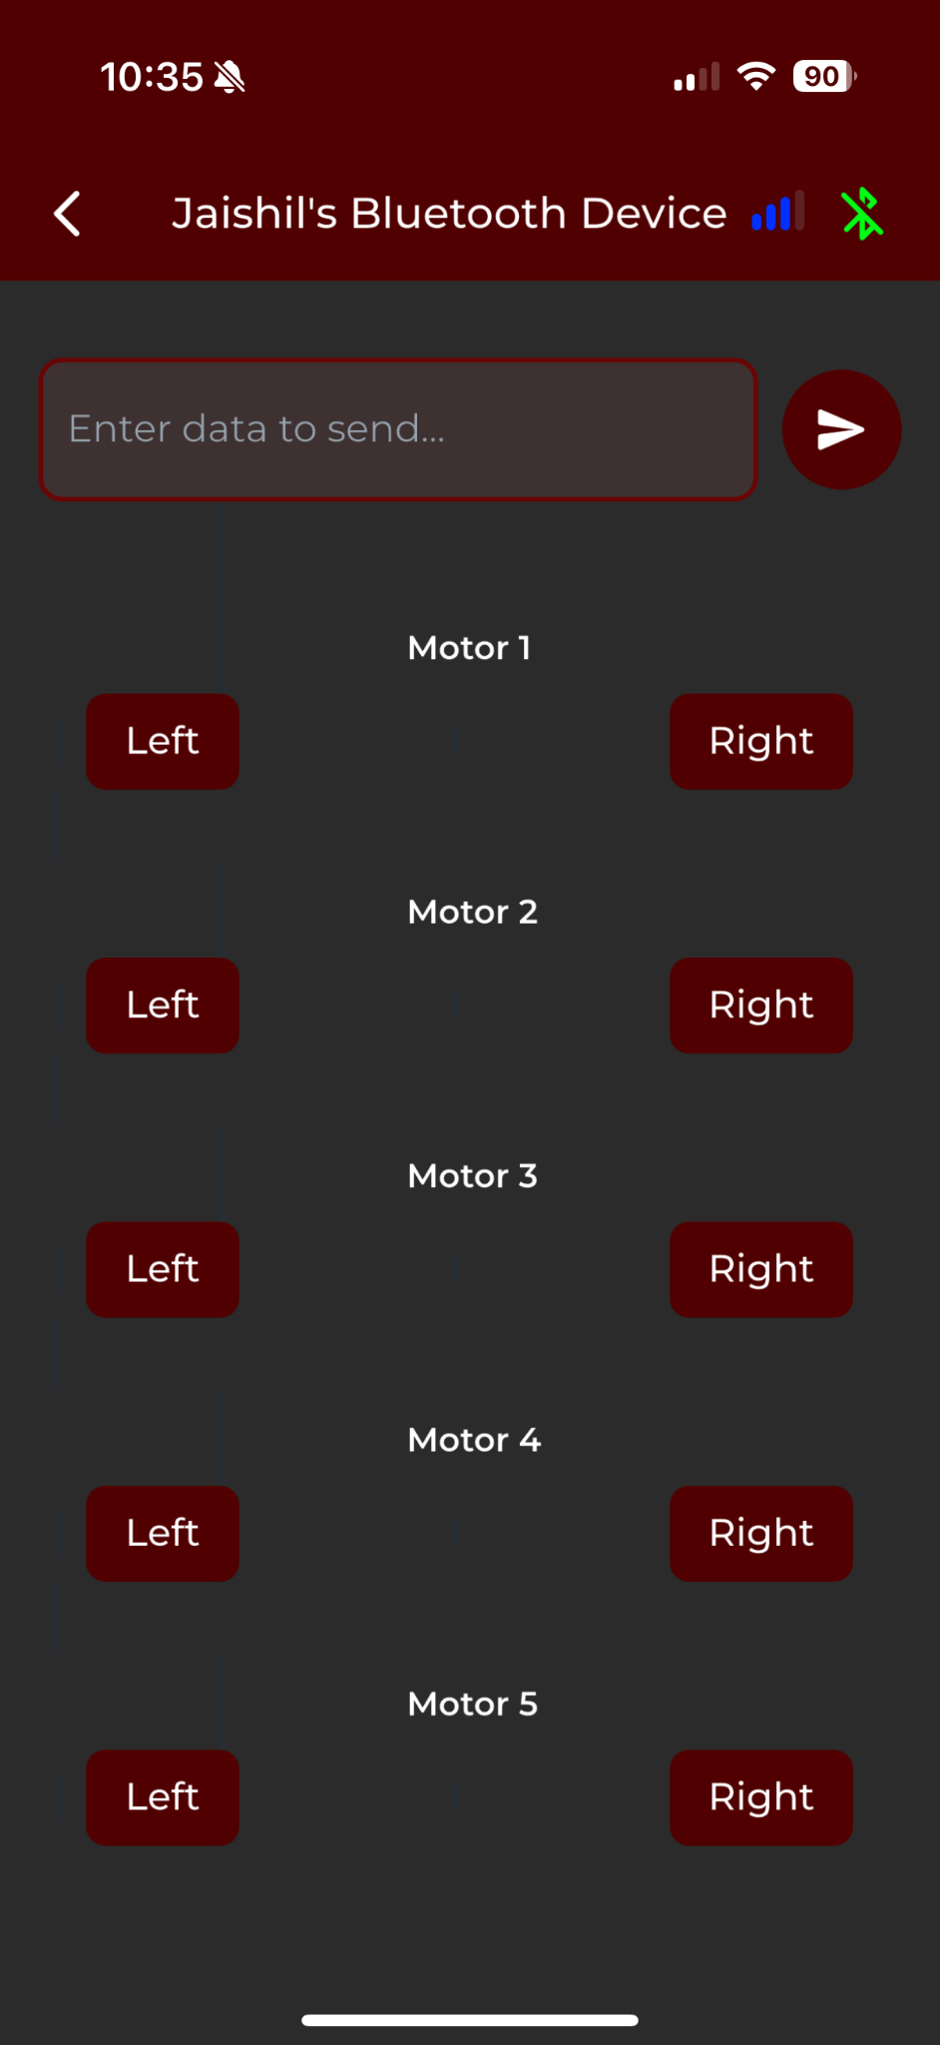
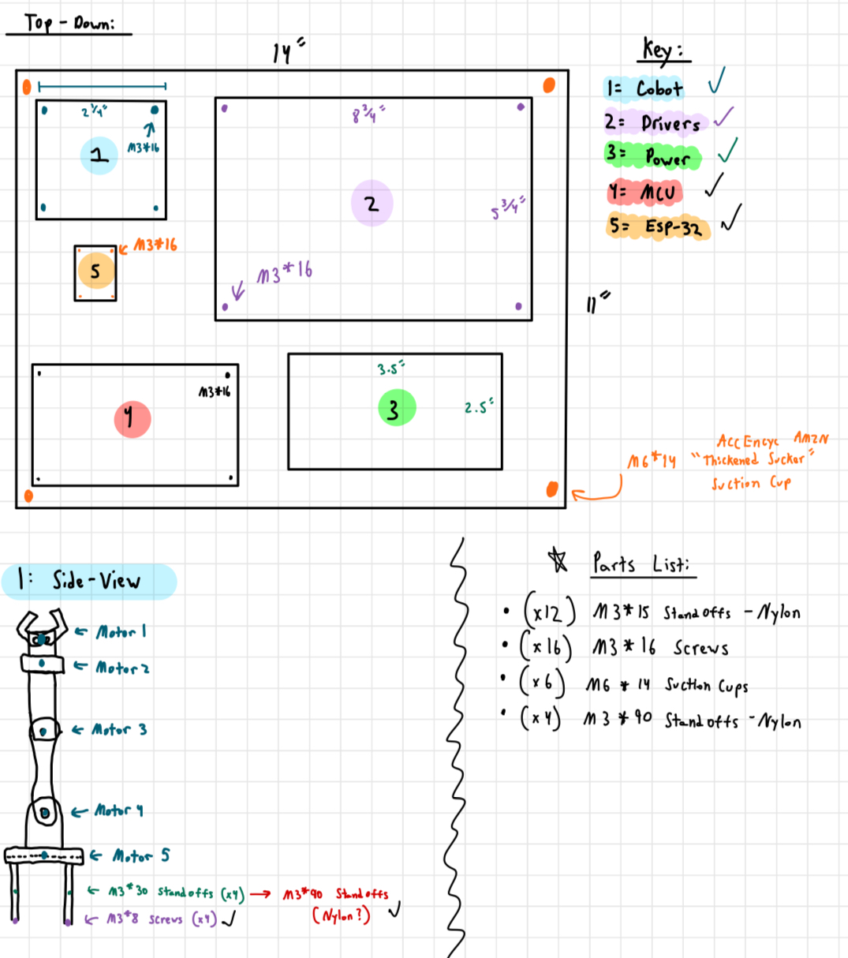
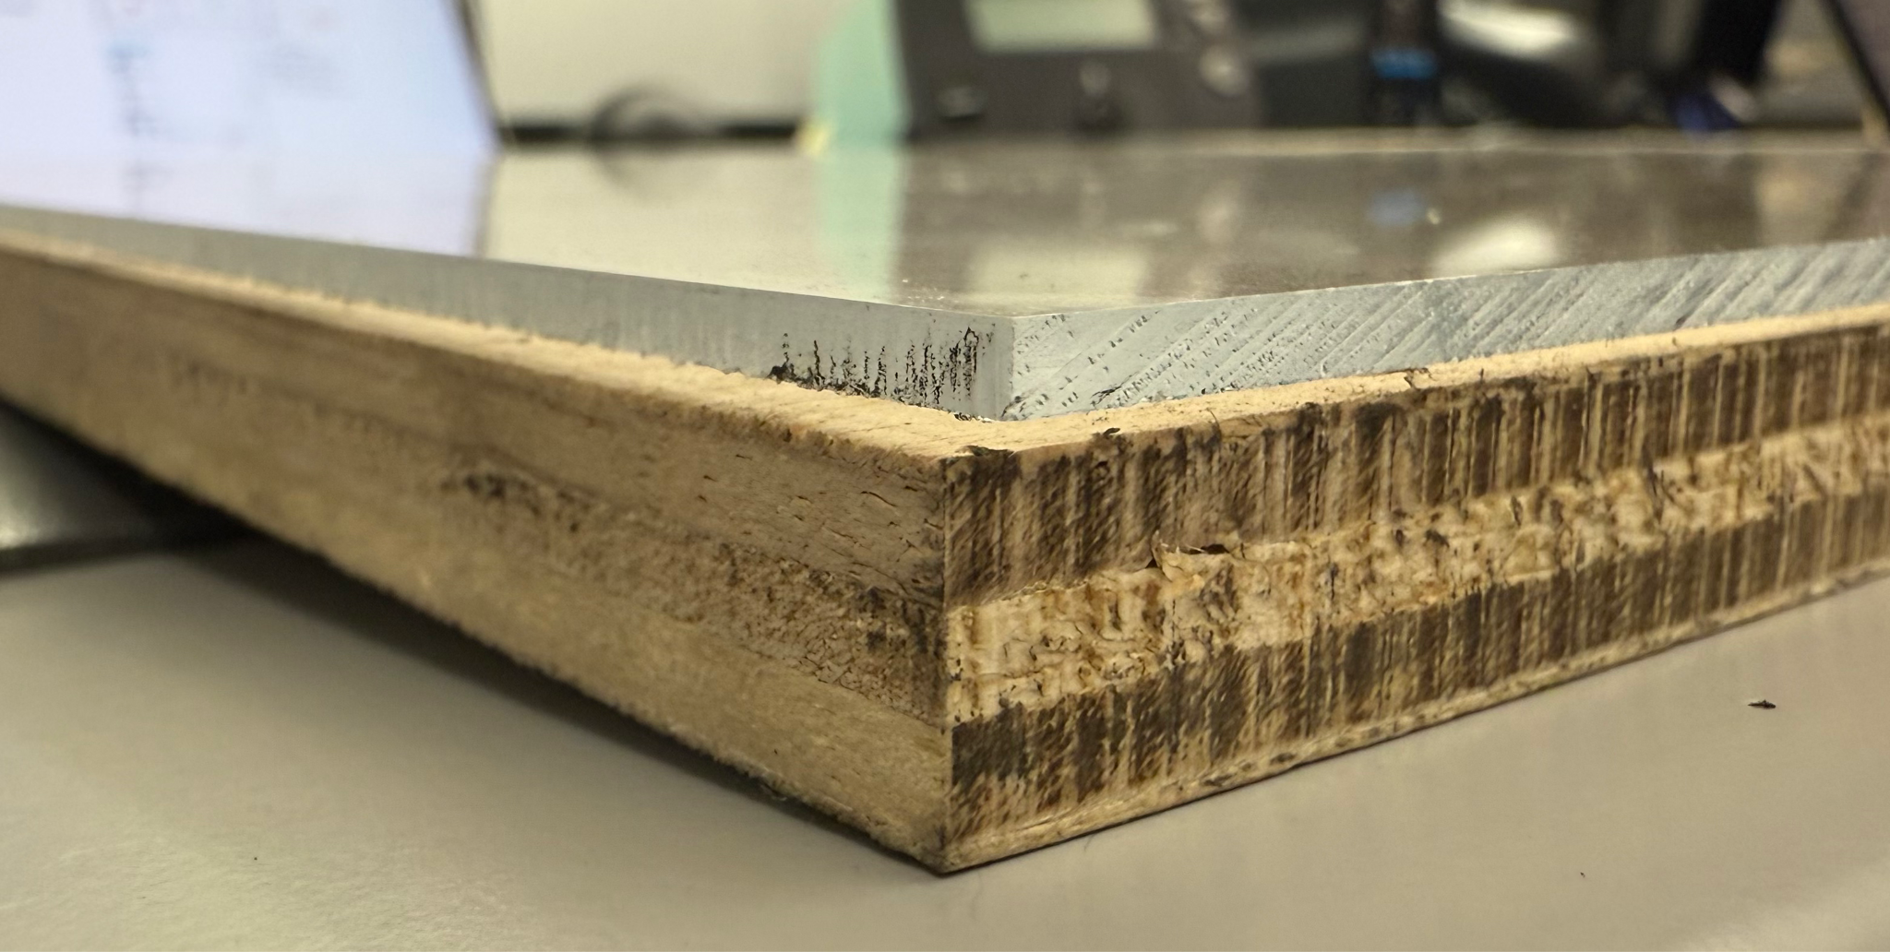
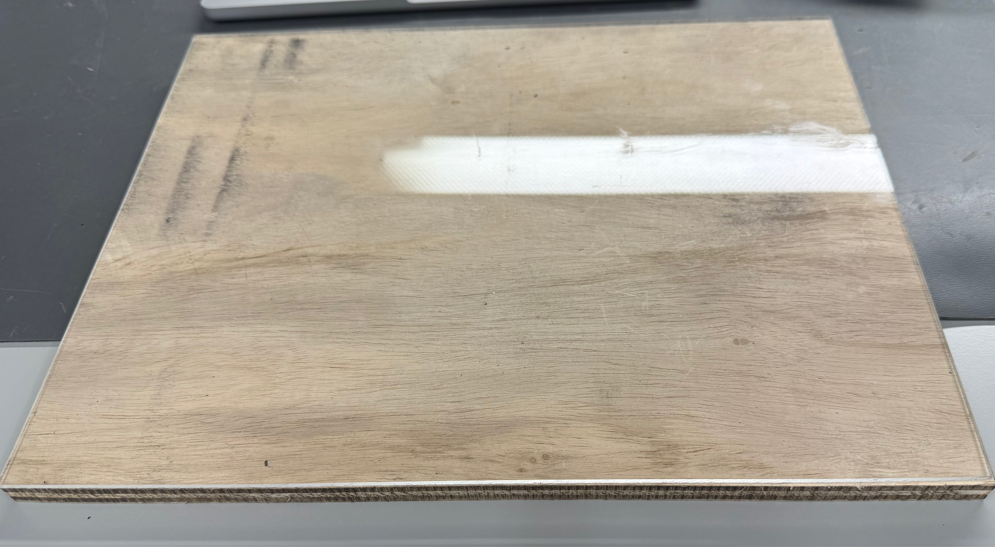
UI/Wireless Connectivity Subsystem
Jaishil Shah

Slide 15
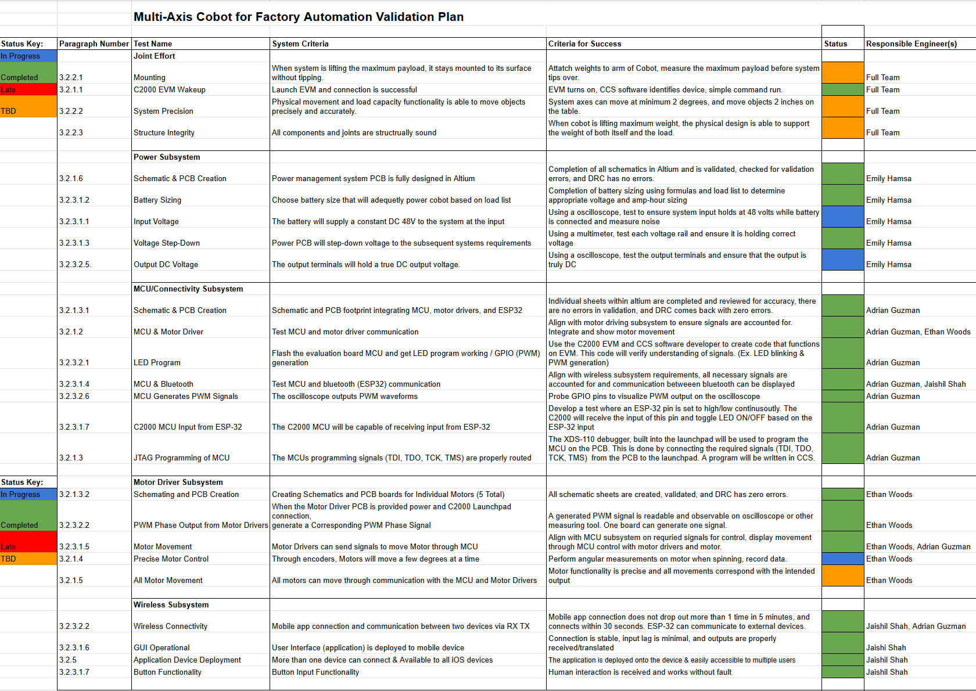
Validation Plan
Notes:
Michelle

Slide 16
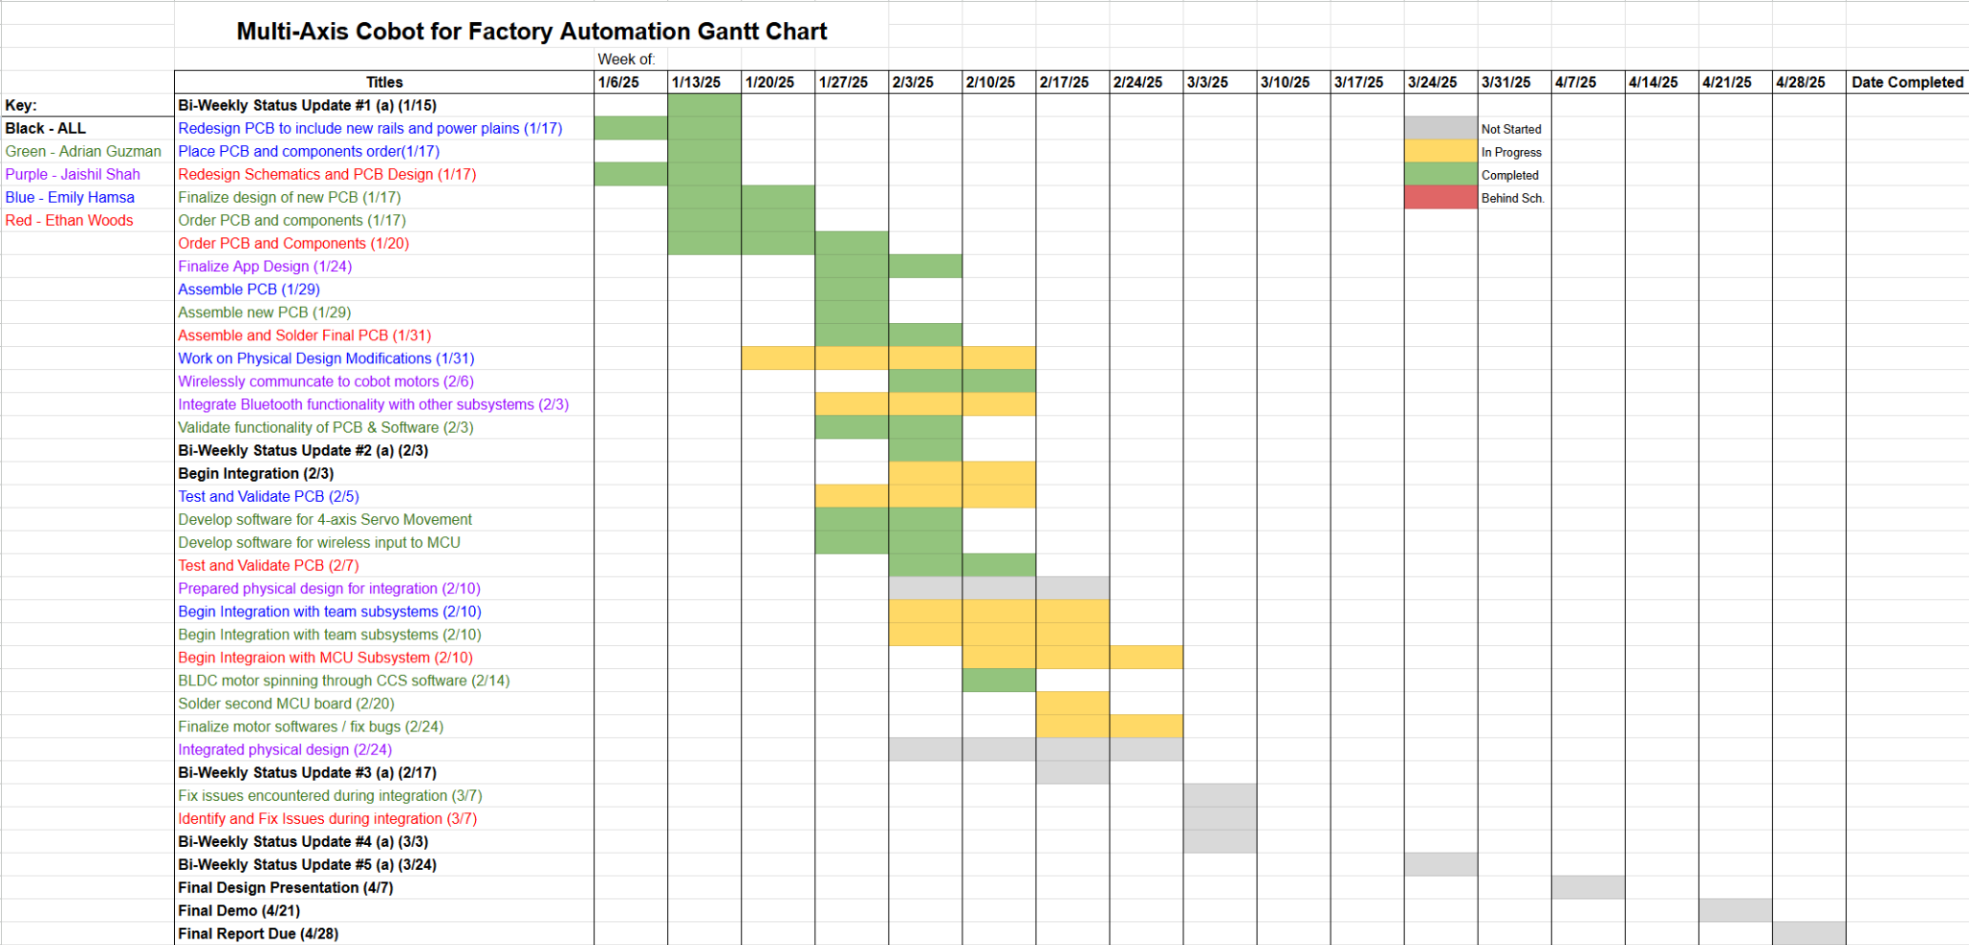
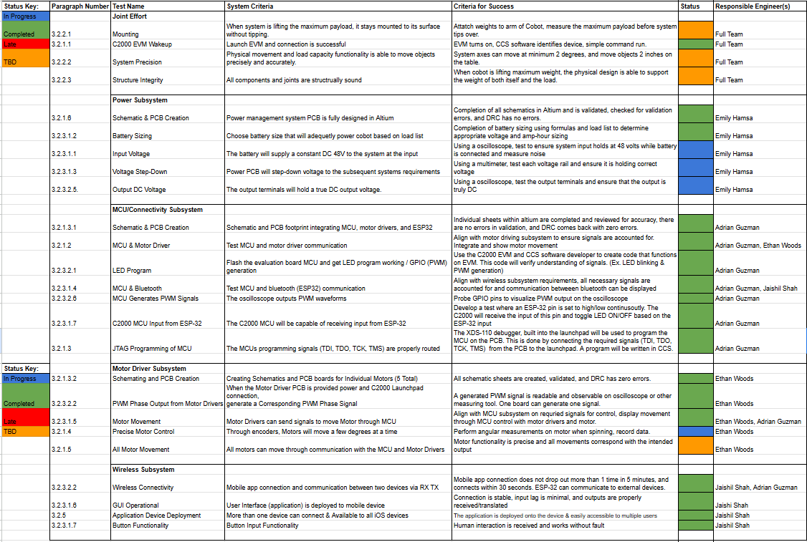
Execution Plan
Notes:
Michelle

Slide 17
Thank You!

